Slide 1
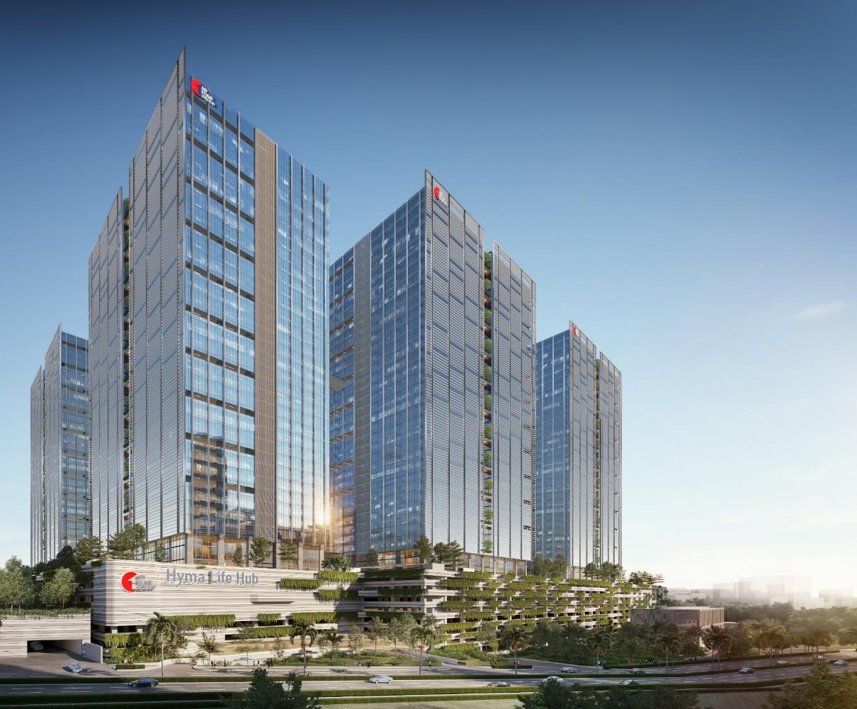
Hyma Developers
WELCOME
HYMA - LIFEHUB

Slide 2
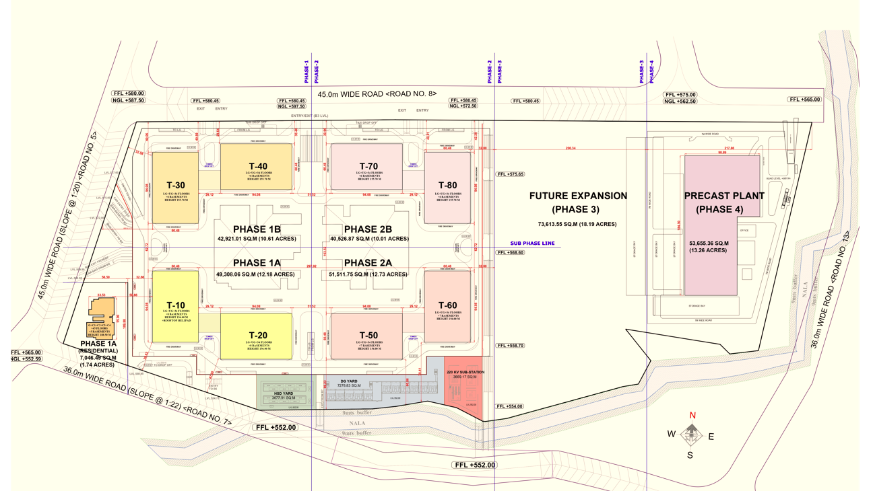
Hyma Developers
PROJECT LAYOUT

Slide 3
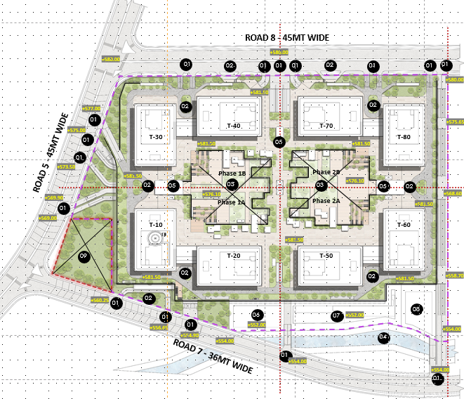
Hyma Developers
PROJECT DETAILS
Phase | Tower | Project Details
Phase 1A | Tower 10 | 8 Basements+LG+UG+34 Floors+Helipad
 | Tower 20 | 8 Basements+LG+UG+34 Floors
Phase 1B | Tower 30 | 6 Basements+LG+UG+34 Floors
 | Tower 40 | 6 Basements+LG+UG+34 Floors
Phase 2A | Tower 50 | 7 Basements+LG+UG+34 Floors
 | Tower 60 | 7 Basements+LG+UG+34 Floors
Phase 2B | Tower 70 | 6 Basements+LG+UG+34 Floors
 | Tower 80 | 6 Basements+LG+UG+34 Floors

Slide 4
Hyma Developers
PROJECT HIGHLIGHTS
Life Hub will be the tallest commercial precast building in India.
Total Super Built-up area including all phases is about 26.5 Million Square feet.
Approximately 80,000 precast elements shall be installed in each phase (2 Towers and non tower area)
Tower cranes – lifting capacity of 50 tons with tip load of 12.5 tons at 70 mts jib.
The podium area will be equivalent to the individual tower area.
Targeted for LEED Platinum and IGBC Platinum Building ratings.
Project to be implemented in the BIM framework.
Precast plant with a production capacity of 5 million sqft/year.

Slide 5
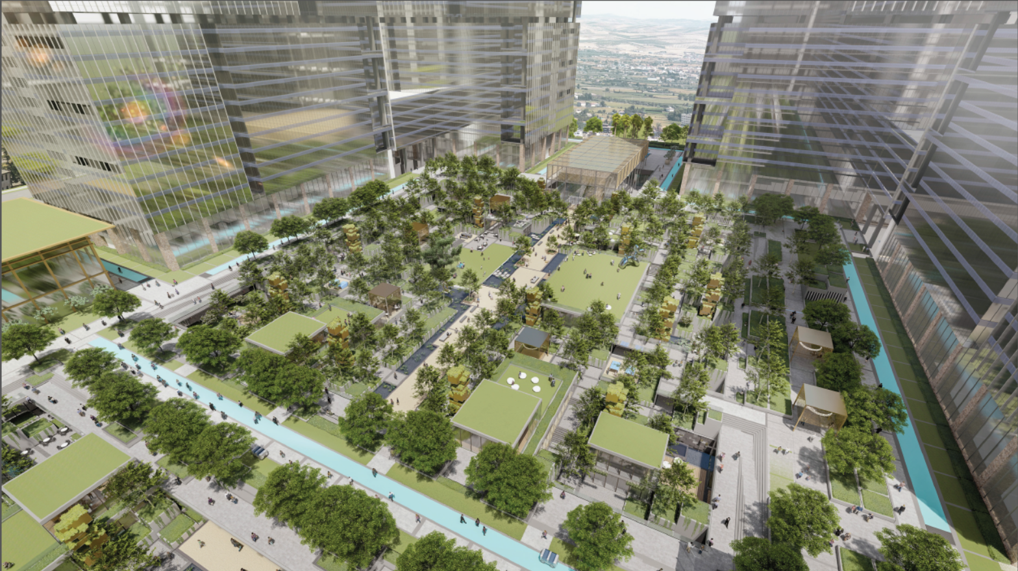
Hyma Developers
PROJECT VIEWS

Slide 6
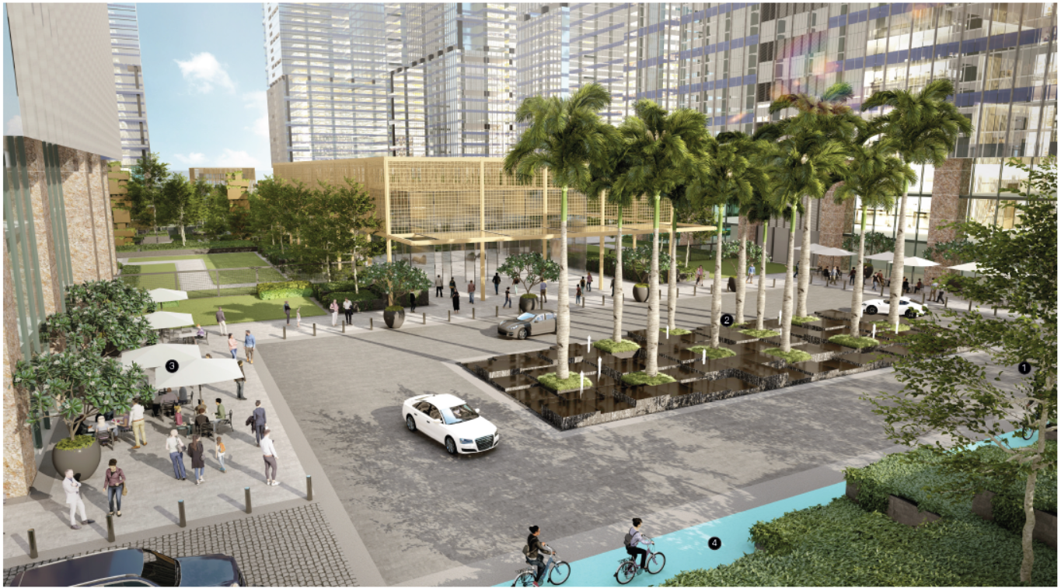
Hyma Developers
PROJECT VIEWS

Slide 7
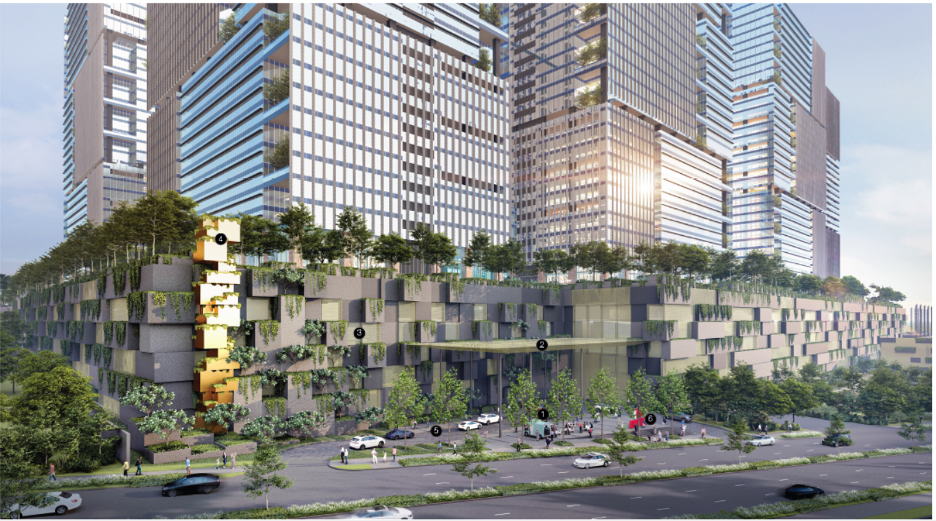
Hyma Developers
PROJECT VIEWS

Slide 8
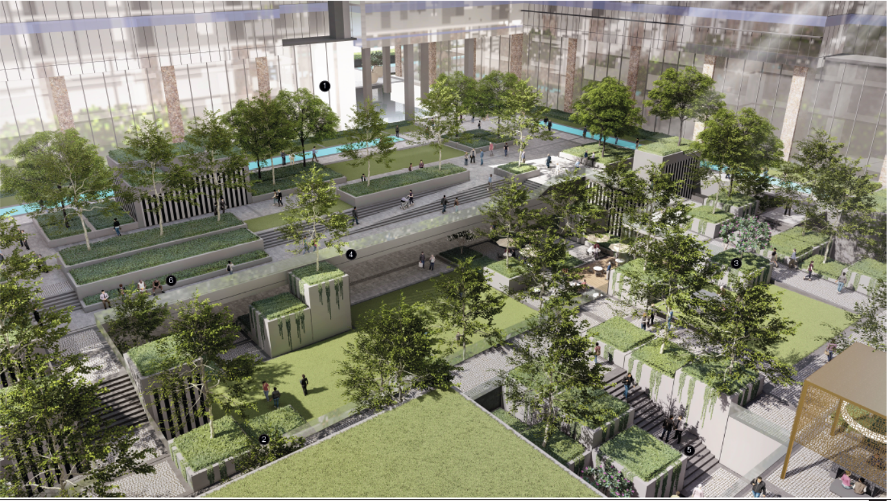
Hyma Developers
PROJECT VIEWS

Slide 9
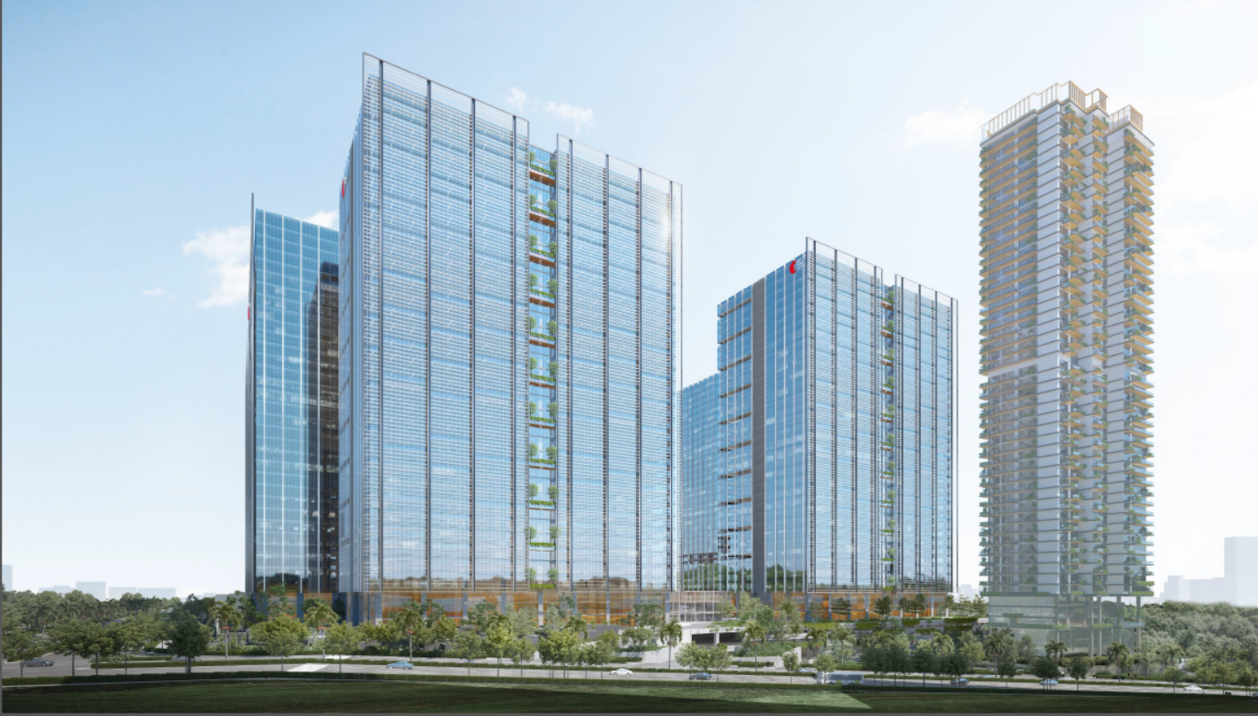
Hyma Developers
PROJECT VIEWS

Slide 10
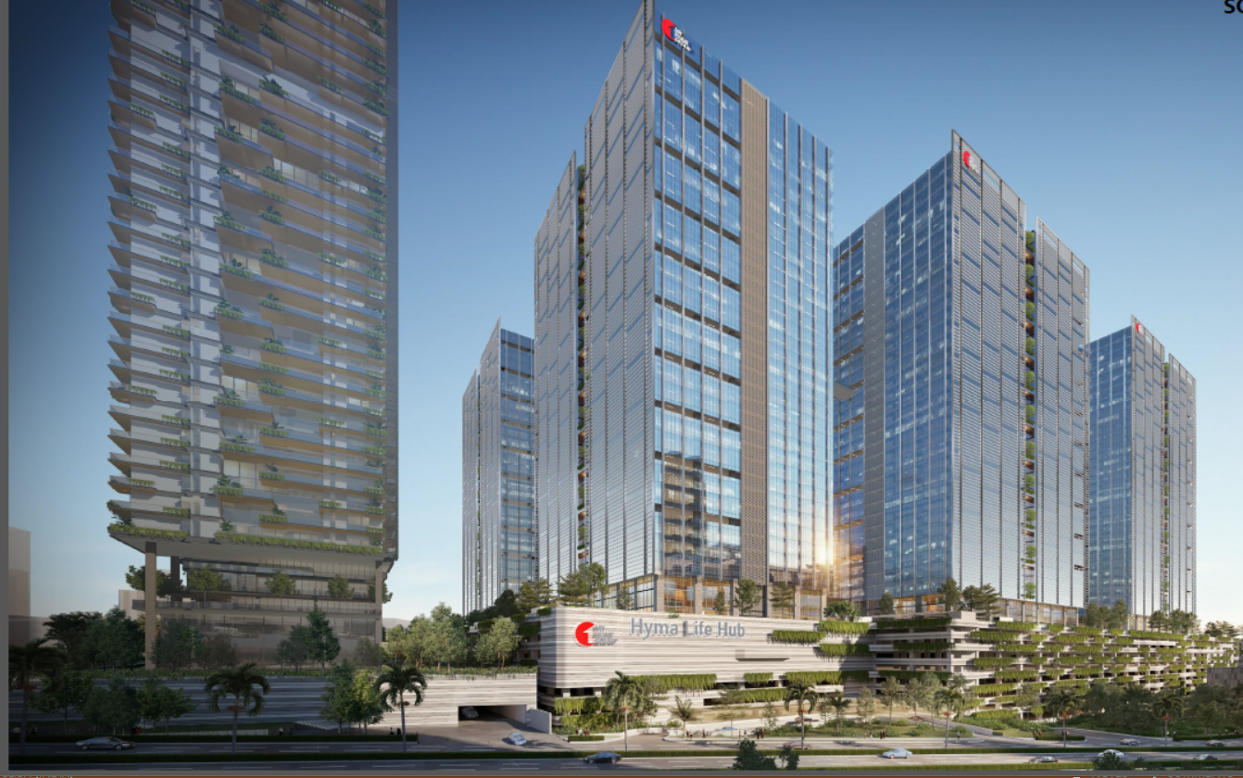
Hyma Developers
PROJECT VIEWS

Slide 11
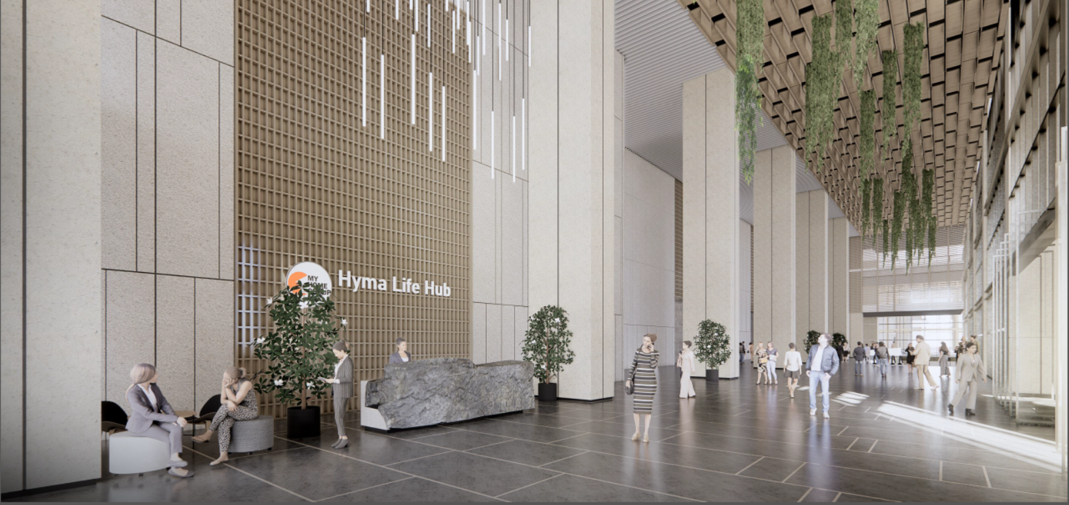
Hyma Developers
PROJECT VIEWS

Slide 12
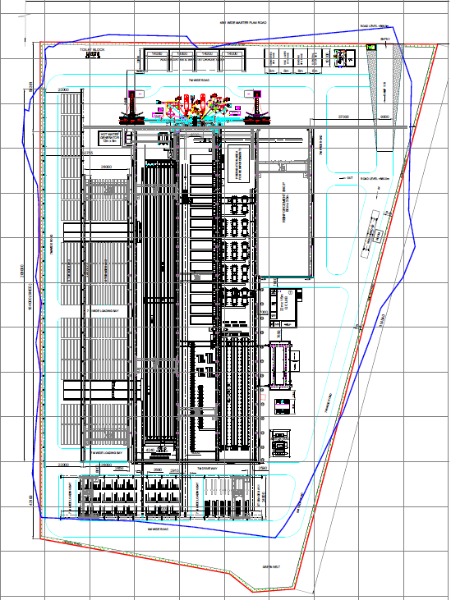
Hyma Developers
PRECAST YARD
S.No. | Hall | Details
1 | Hall 1 | Hollow core slab beds - 8 Nos * 150 m each
2 | Hall 2 | Hydraulic tilting tables – 16 Nos – 12 m*4.5 m Non Prestressed Beam Lines - 84 m length Staircase moulds - 4 Nos
3 | Hall 3 | Double Prestressed Beam Lines - 3 Nos * 60 m each Column Lines - 14 Nos * 9 m each
4 | Hall 4 | Reinforcement yard - cutting, bending and fixing of rebar
H
A
L
L
1
H
A
L
L
2
H
A
L
L
3
H
A
L
L
4

Slide 13
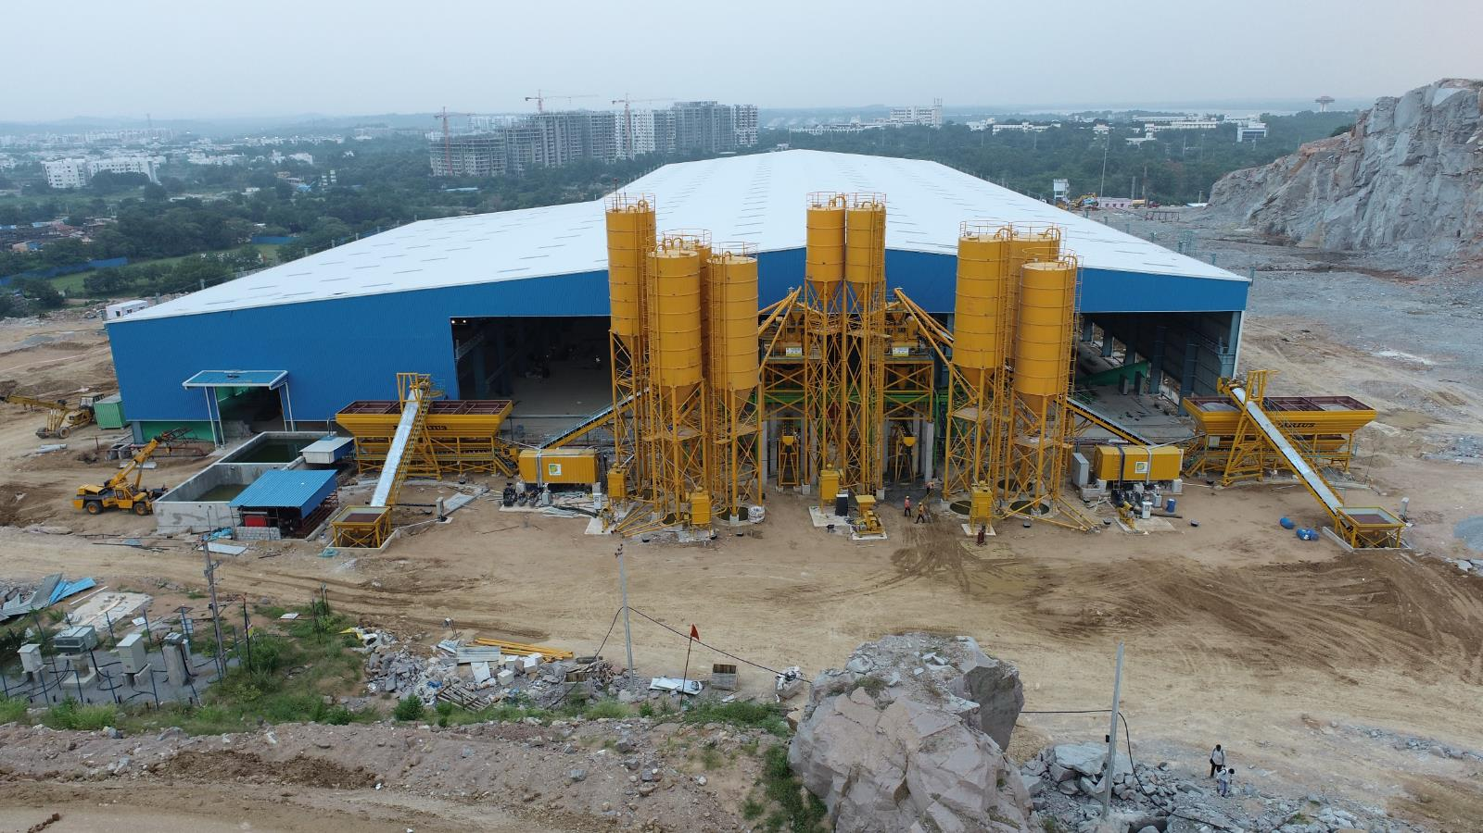
Hyma Developers
PRECAST YARD PHOTOS
Precast Yard Batching Plants

Slide 14
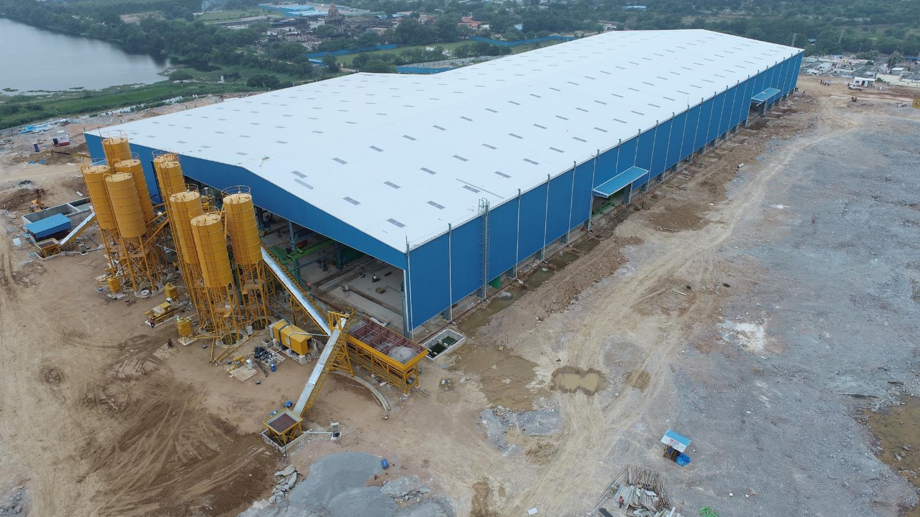
Hyma Developers
PRECAST YARD PHOTOS
Precast Yard

Slide 15
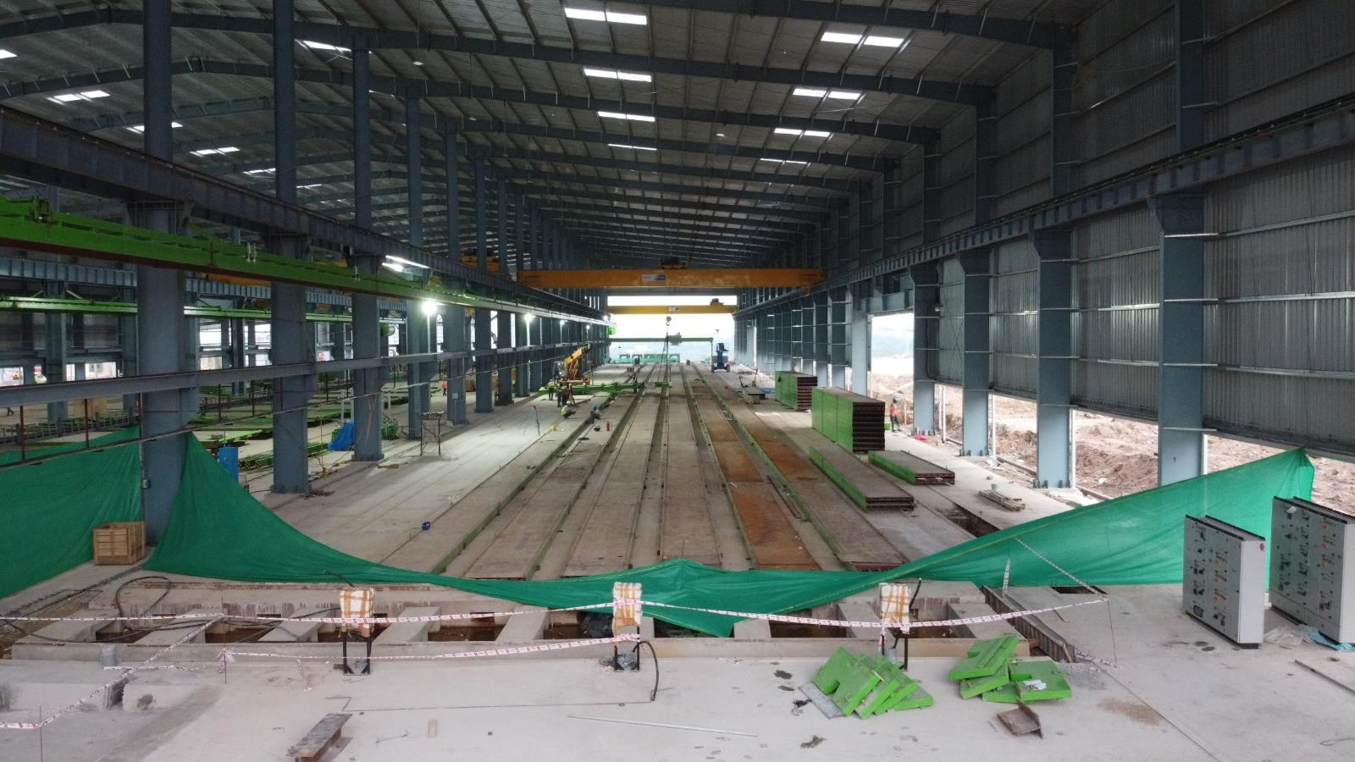
Hyma Developers
PRECAST YARD PHOTOS
Precast Yard – Hall 1

Slide 16
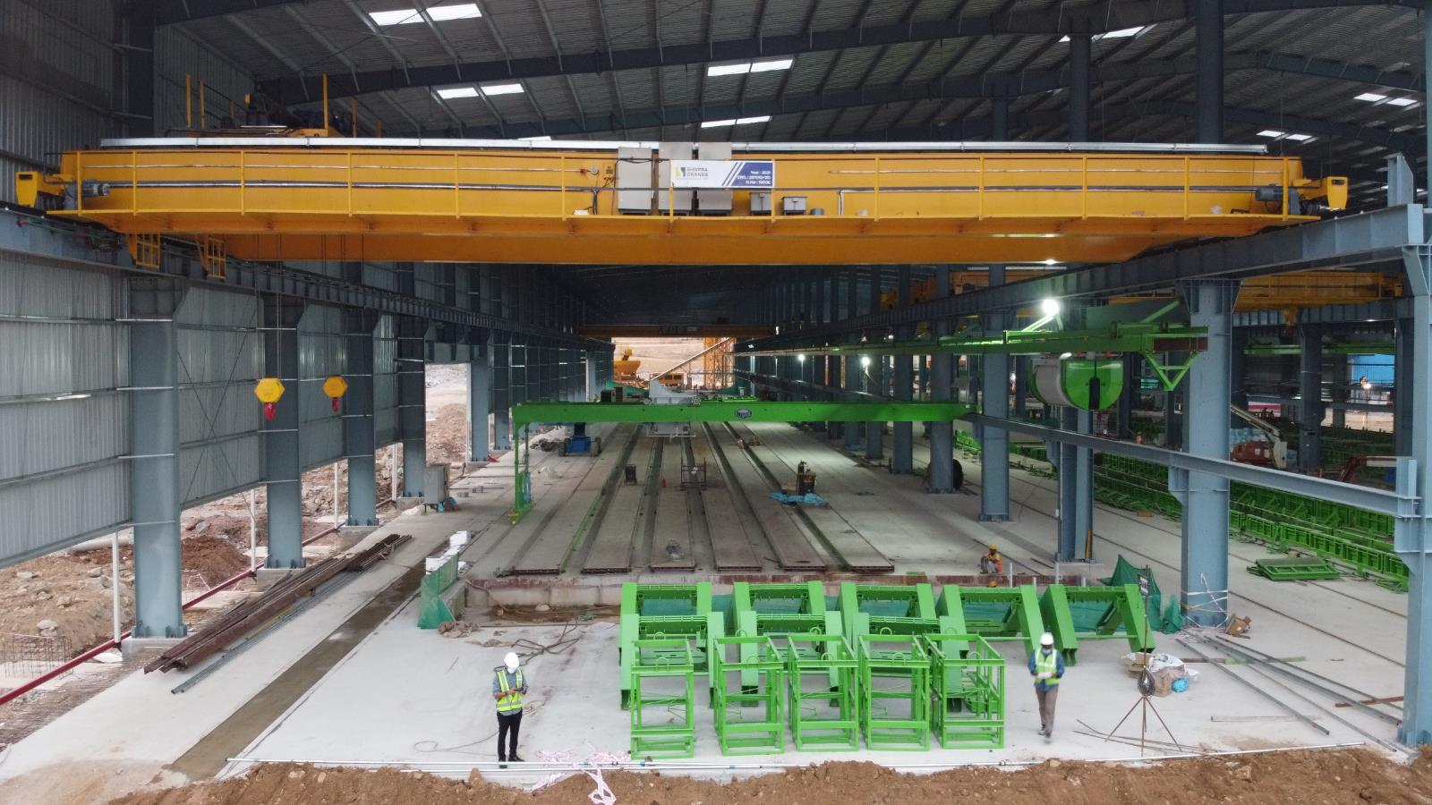
Hyma Developers
PRECAST YARD PHOTOS
Precast Yard – Hall 1

Slide 17
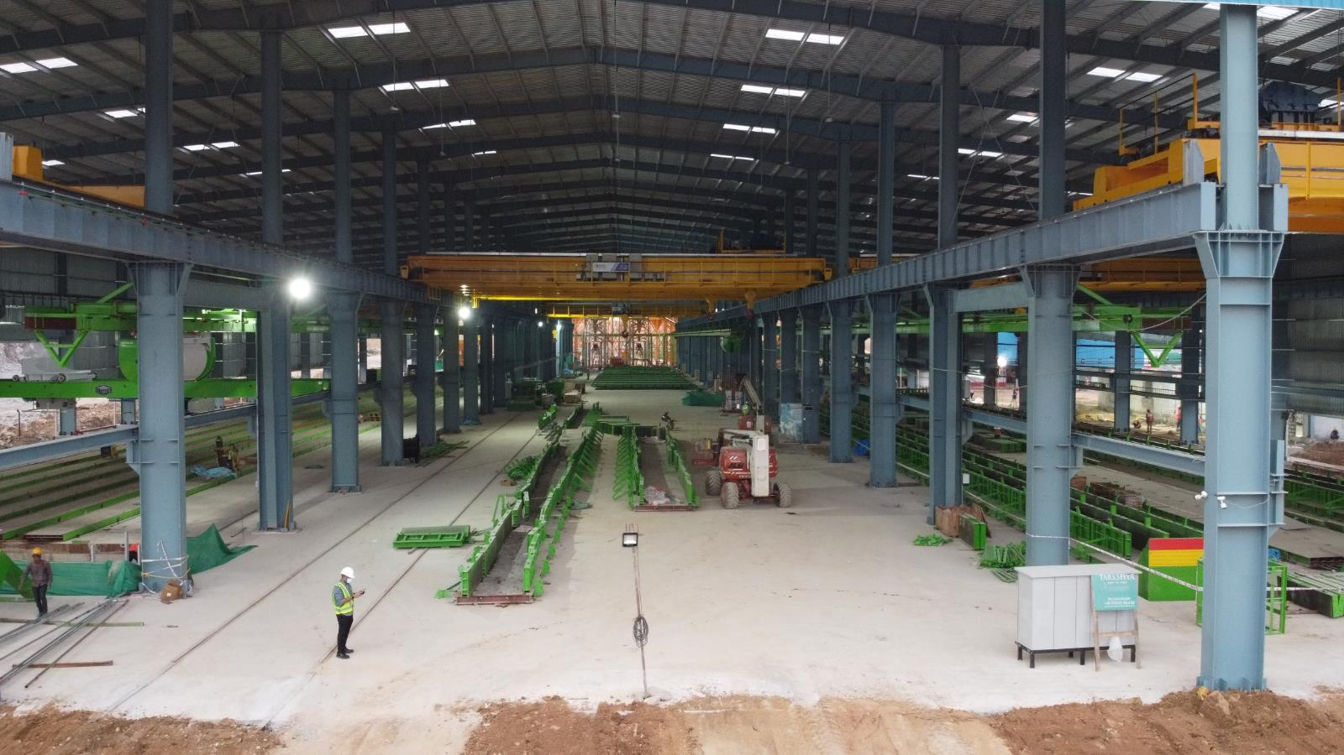
Hyma Developers
PRECAST YARD PHOTOS
Precast Yard – Hall 2

Slide 18
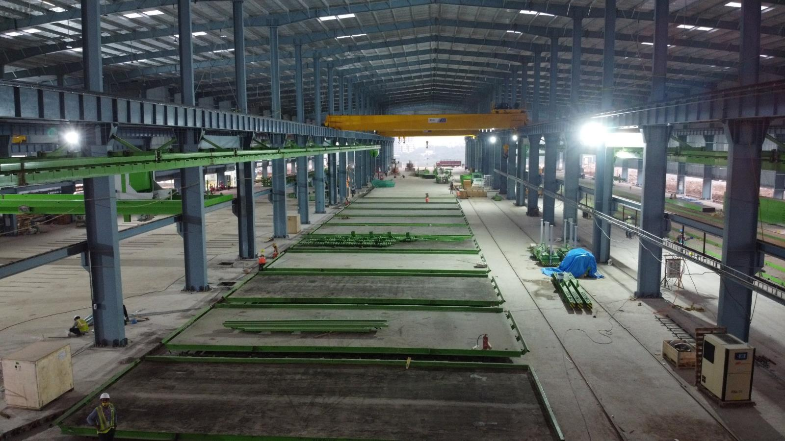
Hyma Developers
PRECAST YARD PHOTOS
Precast Yard – Hall 2

Slide 19
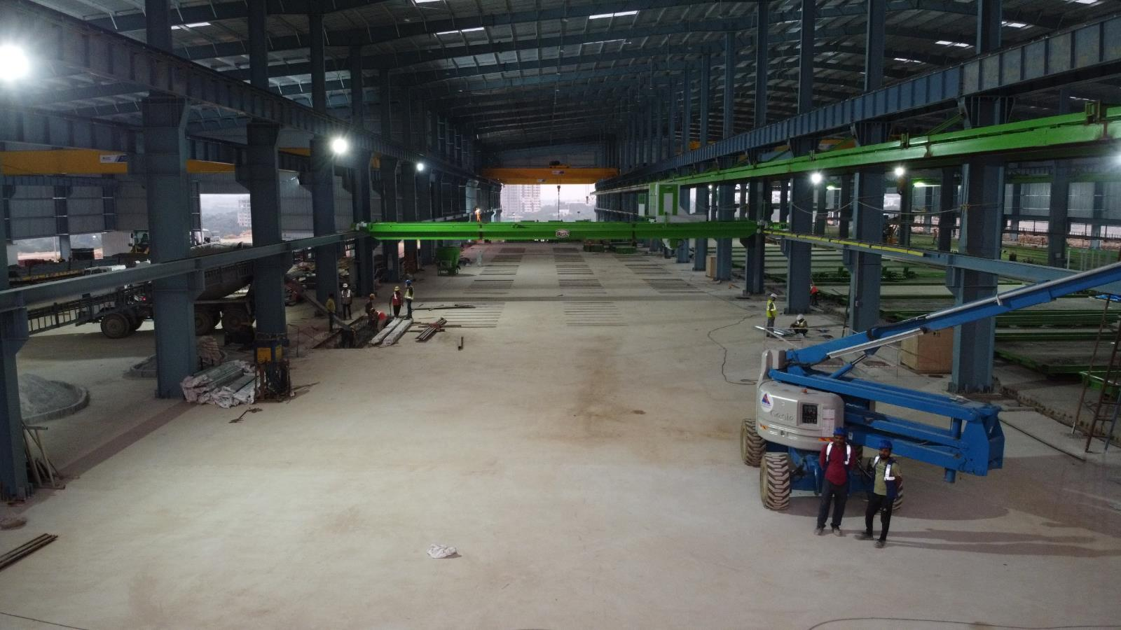
Hyma Developers
PRECAST YARD PHOTOS
Precast Yard – Hall 3

Slide 20
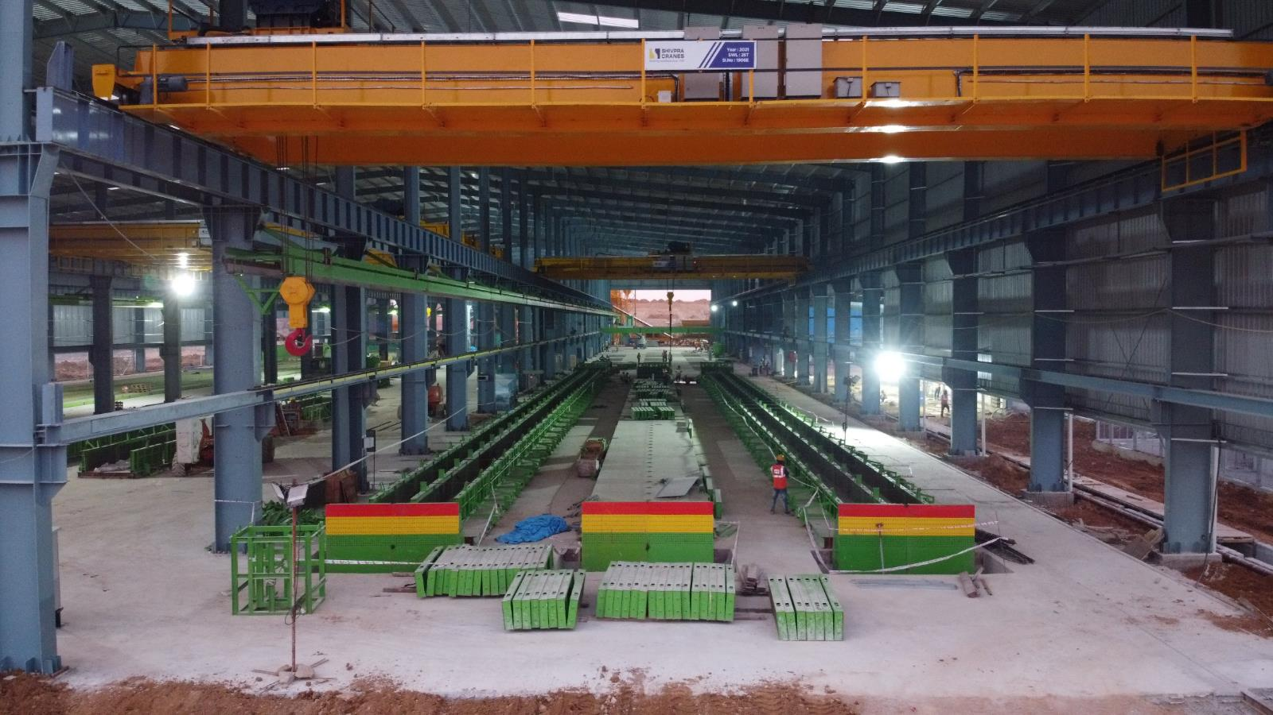
Hyma Developers
PRECAST YARD PHOTOS
Precast Yard – Hall 3

Slide 21
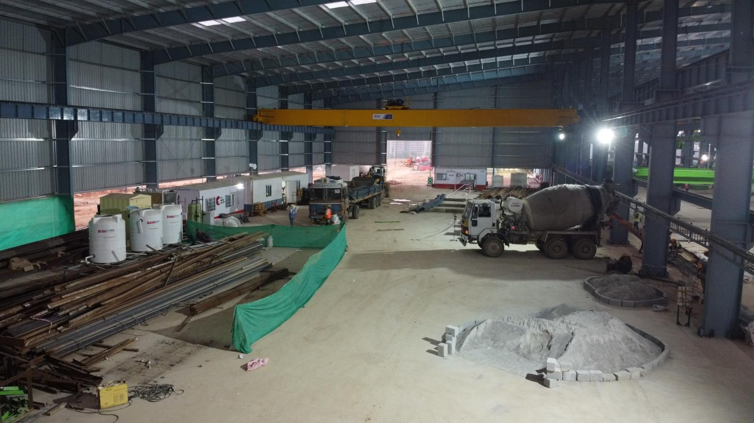
Hyma Developers
PRECAST YARD PHOTOS
Precast Yard – Hall 4

Slide 22
Hyma Developers

