Slide 1
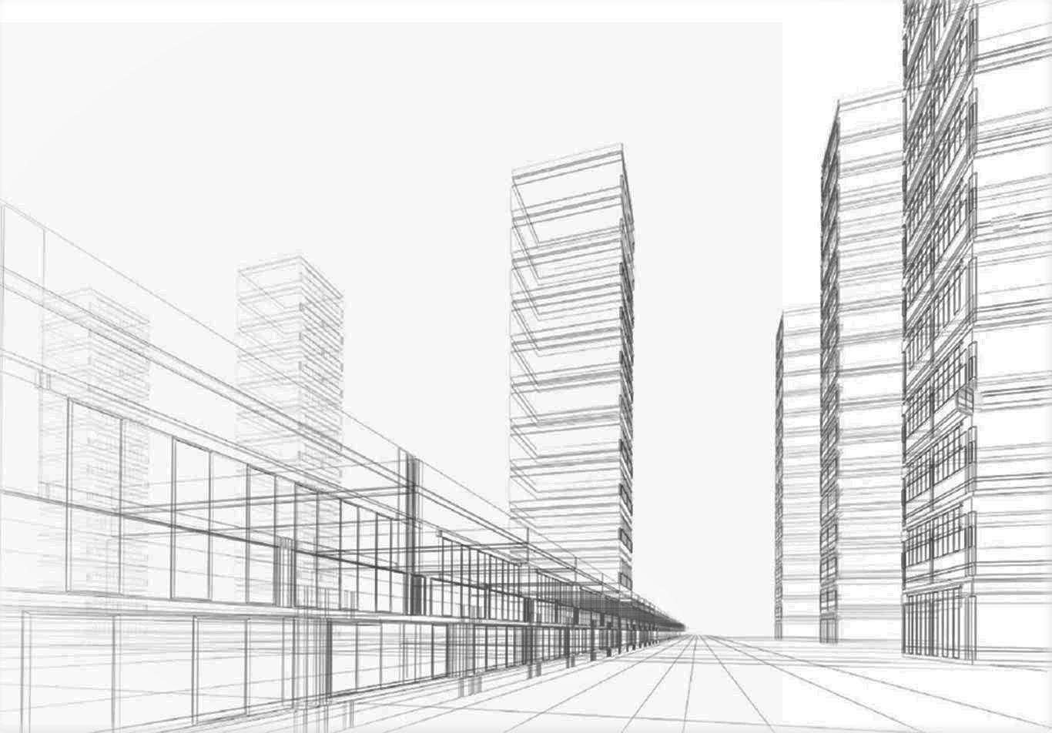

ROBOMATIC
PRECON PVT LTD
ROBO Acotec Wall Panels
SMARTER
STRONGER
FASTER
Notes:
Good morning/afternoon
My name is Rajesh Simon and I am here to represent Robomatic Precon Pvt Ltd.
Robomatic Precon is the Pioneer in the manufacture and installation of Pre cast Hollow core wall panels.
We have installed 80000 sq m of wall panels in our first year, 125000 sq m in our second year and 180000 sq m in our third year a total of 365000 sq m. This has been possible due to the repeat orders we have been able to secure from our esteemed clients based on the excellent quality of our product and the high quality of service we provide. .
I have today with me Mr. Harshith Kosaraju and Mr. Santosh If you have any queries or clarifications regarding our product or services myself and our team will be available at stall 18 after we have made this presentation and we request you to feel free to come and meet with us
Let us now take a look at a small video which would give you an insight into the Manufacturing and Installation process for Robo Acotec Wall panels. This video also includes a message from our Managing Director Mr. Vijay Kumar Kosaraju.

Slide 2
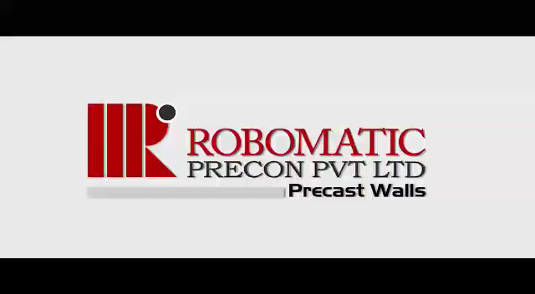
CORPORATE VIDEO
Notes:
Corporate Video

Slide 3
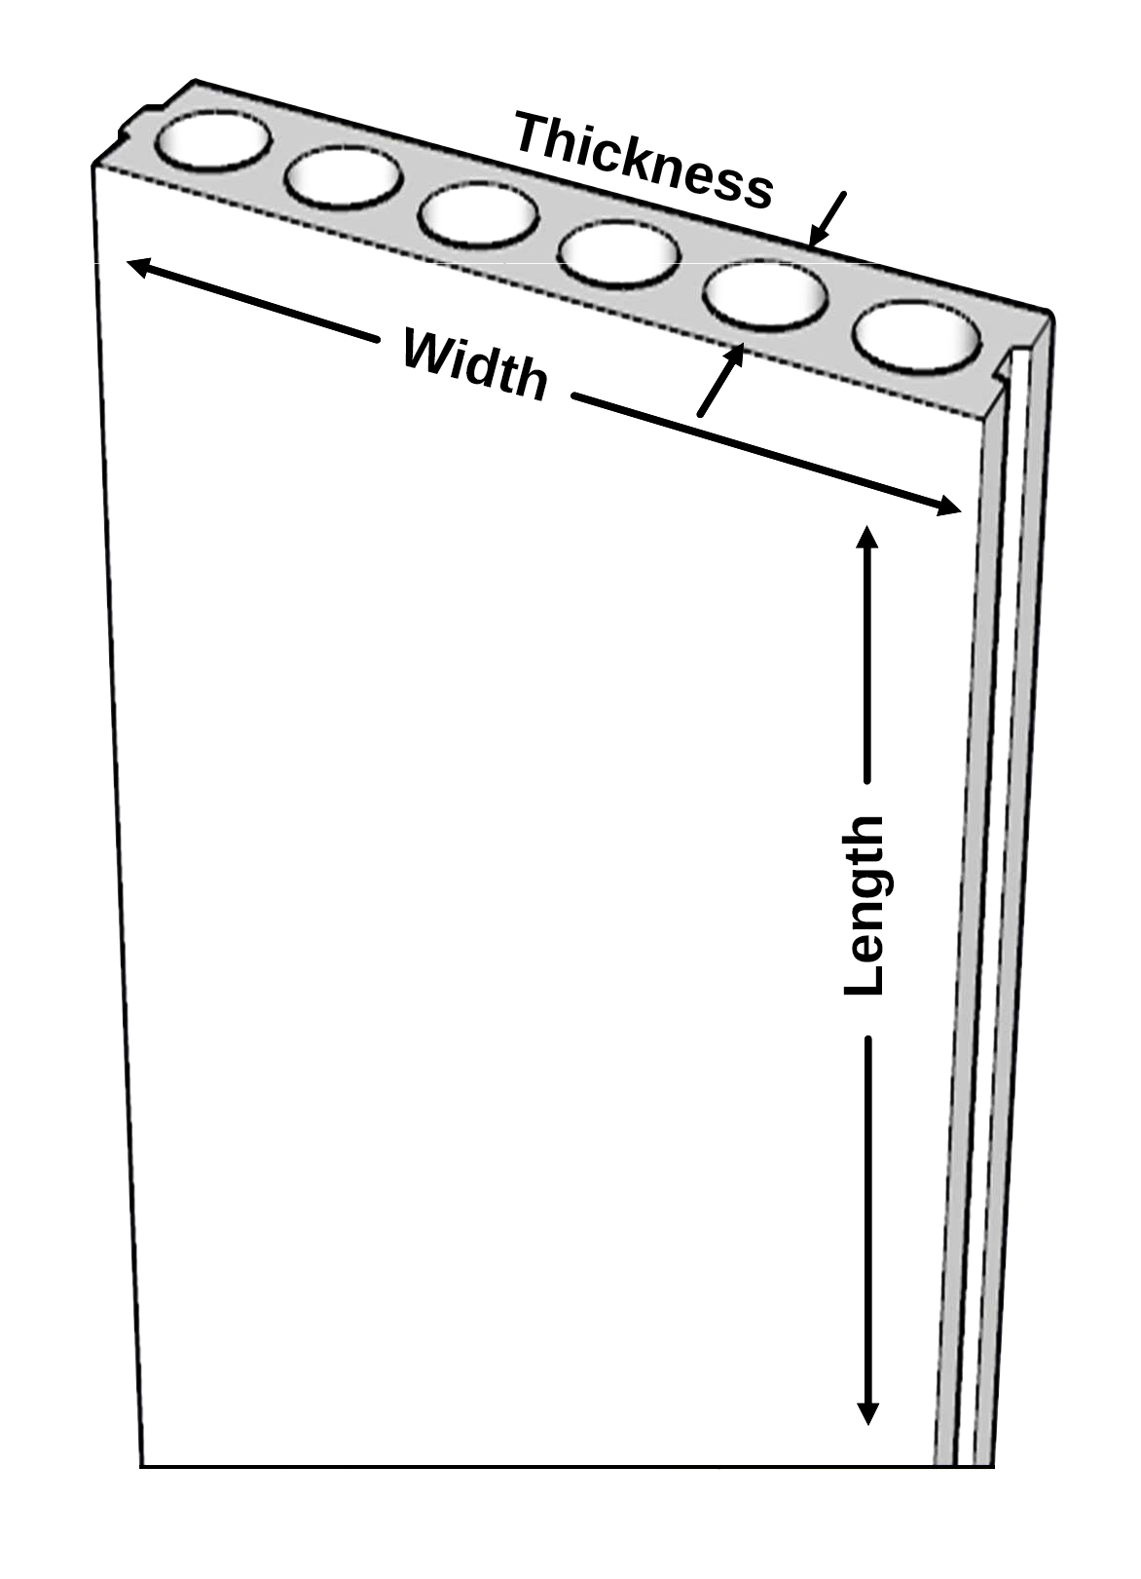
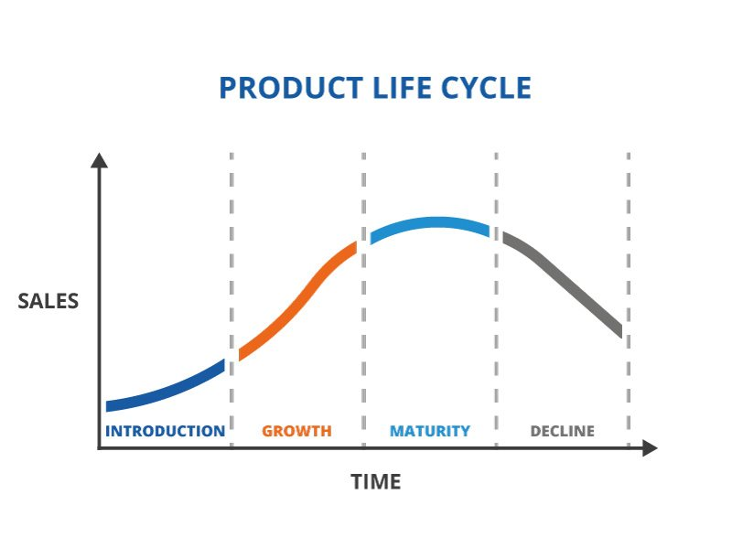
PRODUCT – ROBO ACOTEC WALLS
Acotec wall is a product which is expected to substitute and revolutionise the construction Industry.
Substitute for Red bricks, Cement bricks, fly-ash Bricks, Cellular Blocks and AAC bricks
Acotec Walls are a game changer in the Construction industry.
People have realised the value of their time and health as a result of the Pandemic. To the maximum extent possible, the product saves time and reduces manual involvement in
Manufacturing process
Installation process
Thickness of Panels : 75mm, 92mm and 120mm
Length of Panels : 2.4m to 3.3m
(Note: Constructability height can go up to 4.5 meters
via staggered joints.)
Width of Panels : 600mm
Weight of the panels :
  120mm thickness panel - 155 kg/sq.m
  92mm thickness panel - 135 kg/sq.m
  75mm thickness panel - 112 kg/sq.m
Notes:
This slide gives you some specifications of our product Robo Acotec Walls.
Robo Acotec Wall panels are manufactured with a standard lengths ranging from 2.4 Mts to 3.3 mts.
We can achieve heights of up to 4.5 mts using Staggered joints as required by the client.
Robo Acotec Walls come with a standard width of 600 mm
Robo Acotec Walls are available in Three variants of thickness
75 mm
92 mm
120 mm

Slide 4

COMPARATIVE FEATURES
S No | Description of Item | Acotec Wall | Block Work
1 | Compressive Strength (N/mm2) | 10-13 | 3.45
2 | Flexural Strength (N/mm2) 75 mm : 5; 92 mm : 2.5; 120 mm : 3.5 | 3.5 | <1
3 | Water Absorption Ratio (%) | 5.7 | >10
4 | Dry Density (Kg/m3) | 1405 | 1400
5 | Drying Shrinkage (%) | 0.04 | 0.04
6 | Sound Reduction Index (dB) | 50 | 42
7 | Fire Rating (Hrs) | 2 | 2
8 | Thermal Conductivity (W/m-k) | 0.4 | 0.34
Acotec walls are technically certified by NABL accredited Laboratories and BMTPC (Govt. of INDIA)
Spectro Labs and Analytics
Bureau Veritas
Sigma Laboratories
JNTU
Notes:
Here are some Technical comparison details between Rob Acotec Walls and Brick work
We have also listed details of Testing accreditation center's where our product has been tested and certified

Slide 5








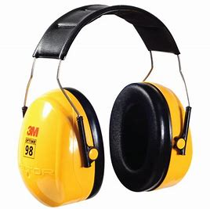

FEATURES/ ADVANTAGES
FLEXIBLE DESIGN
REDUCE WASTE
ECO - FRIENDLY
RELIABLE AND DURABLE
7 X FASTER
ECONOMICAL
SAVES TIME
MORE CARPET AREA
SAVES TIME
THERMAL and SOUND INSULATION
NO PLASTERING AND CURING
Notes:
Here are some of the features and advantages of using Robo Acotec walls compared to using conventional methods for construction

Slide 6
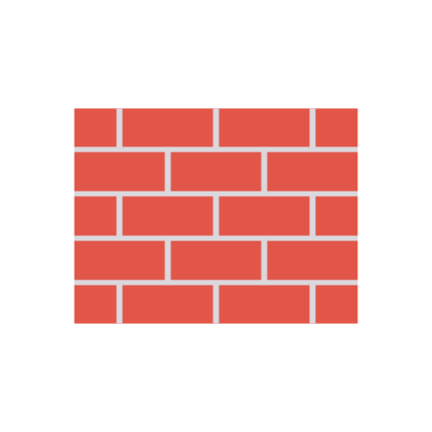




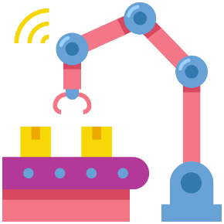

CONVENTIONAL WALL V/S ROBO ACOTEC WALL
Made of Bricks, cement, sand, curing, plastering
A Traditional wall with a slew of flaws
House made of bricks
Workmen to build brick wall
Precision casting, using concrete as the main ingredient, and all machine built with precise cuts and curing, as well as automated stacking.
Flexible, Reliable, Durable, Eco-friendly ROBO ACOTEC WALL
House made of ACOTEC WALLS
70% less workmen to build same wall
Notes:
Process with advantages and drawbacks of constructing a wall with the conventional method and also by using Robo Acotec walls

Slide 7
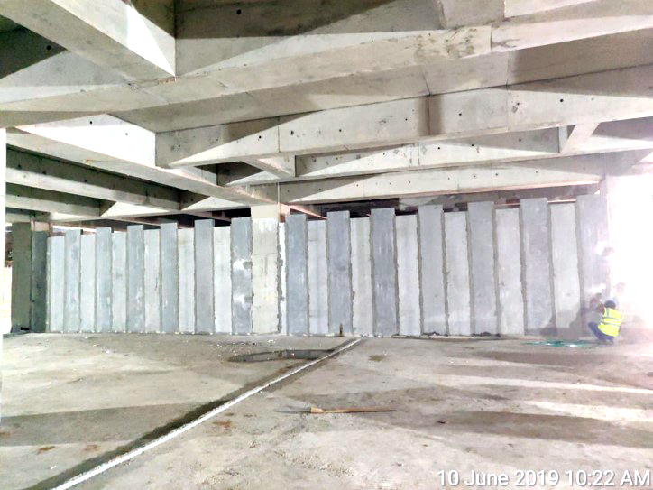
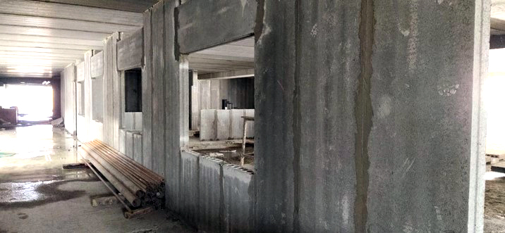
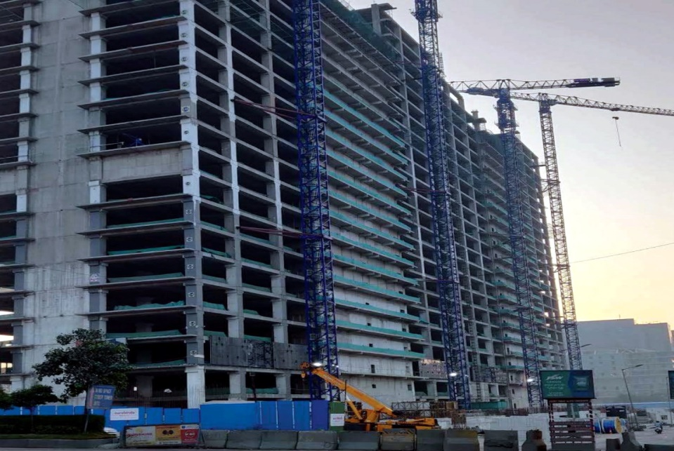
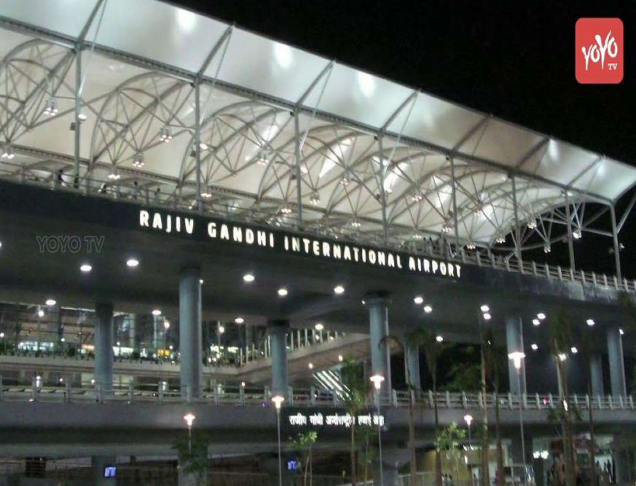
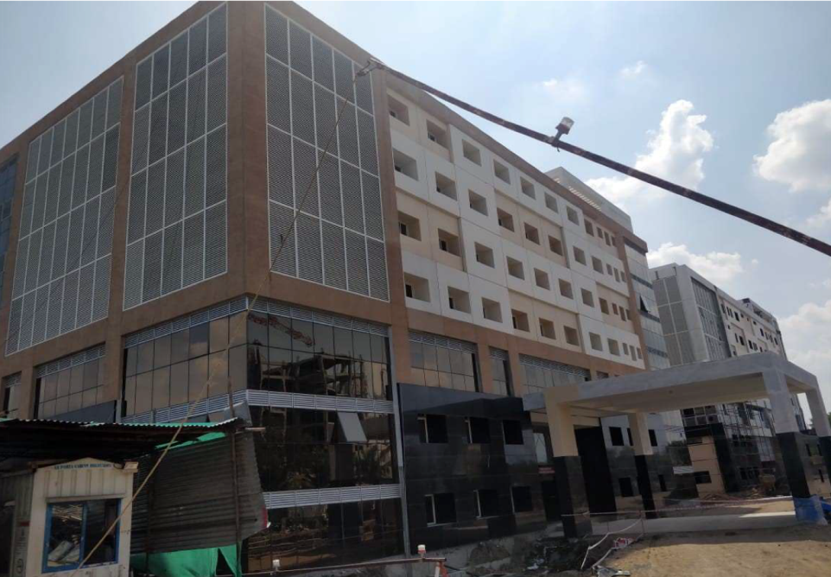
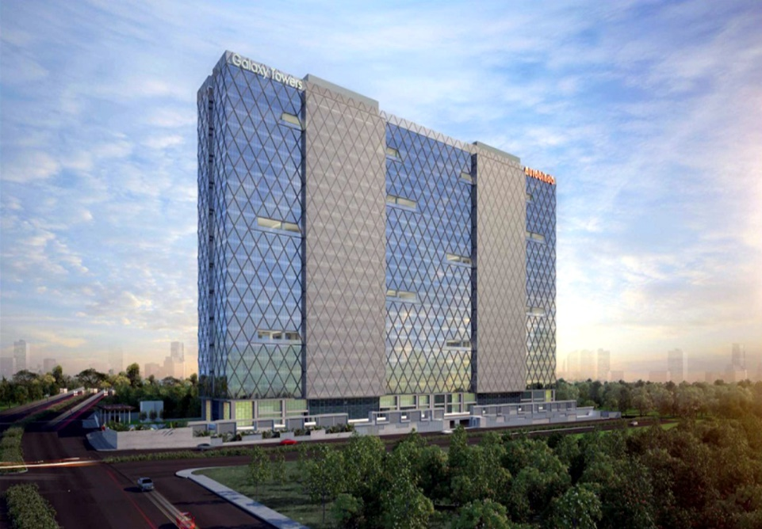
NOTABLE PROJECTS EXECUTED
Rajiv Gandhi International Airport
Kovai Medical College and Hospital ­ Coimbatore
Galaxy Towers – Aurobindo
Notes:
Here are some notable projects we have completed using Robo Acotec wall panels
Rajiv Gandhi International Airport at Shamshabad Hyderabad
GMR – L&T contract – executed by Robomatic Precon
Kovai Medical College and Hospital – Coimbatore
Galaxy Towers Aurobindo - Hyderabad

Slide 8
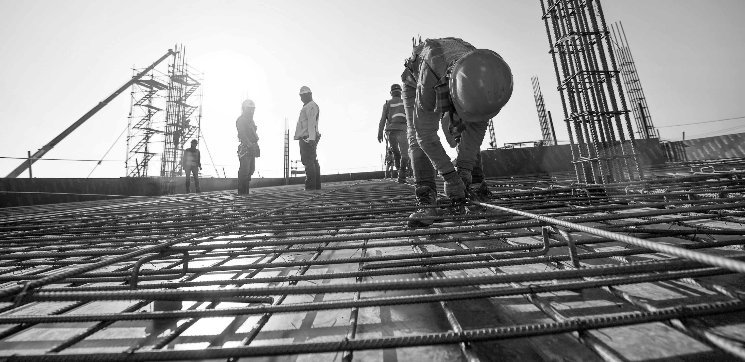



















Recognized NAMES
Who trust in
OUR COMPANY
Delhi Public School
Notes:
We have listed some of our esteemed clients where we have completed projects using Robo Acotec Wall Panels

Slide 9


WE PROMISE TO CONSTANTLY INNOVATE
WE PROMISE TO ADHERE TO ENVIRONMENTAL STANDARDS
WE PROMISE TO KEEP ELEVATING OUR QUALITY
AND WE PROMISE TO ALWAYS DESIGN PRODUCTS THAT IMPROVE LIVES
Notes:
Our Commitment to innovate and develop new methods and products and to lead the way in the Construction industry

Slide 10
Request you all to include ROBO Acotec Wall Panels in your Technical Specifications and future correspondence with RERA
Thanks to the Organizers for the opportunity to present to you our product
Thanks to all here today for your time and interest shown in our product
Notes:
Having seen the benefits in terms of time saved , Area of construction gains and the suitable pricing of our product, We would like to request all of you to include Robo Acotec wall panels in your technical specifications and future correspondence with RERA
On behalf of our Managing Director I would like to thank the organizers for giving us this opportunity to present to you our product Robo Acotec Walls and also all of you here today for your time and interest shown in our product.
We look forward to working with you in the near future

Slide 11





CONTACT US
Address
Robo House, Plot no: 82, 2nd floor, APHB Colony, Gachibowli, Hyderabad – 500032.
www.robomatic.in
https://www.facebook.com/roboprecon/
Give us call at
+91-994 992 0055 / +91-939 332 3999
https://twitter.com/roboprecon/
E-mail us at
info@robomatic.in
Notes:
Contact Details

